Slide 1
Department of Education (DE)
Statistics Workplan 2026/27

Slide 2
Contents Page
Context and overview
Northern Ireland Statistics and Research Agency (NISRA)
Code of Practice for Statistics
Programme for Government
DE’s Business Plan
Statistical Analysis Team Workplan
Overview of teams and main publications (Pg 7)
Strategic enablers (Pg 16)
Research & Evaluation Team Workplan
Overview of teams (Pg 14)
Strategic enablers (Pg 16)

Slide 3
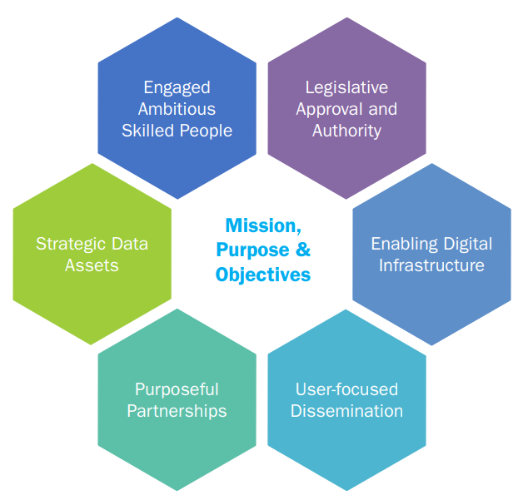
Context and Overview
We are NISRA statisticians seconded to the Department of Education
We contribute to NISRA’s vision to deliver the key statistical, analytical, research and registration services which are needed to improve the lives of people of Northern Ireland. We want to collect, analyse and publish the key information which promotes the education of the people of Northern Ireland and to ensure the effective implementation of education policy.
We help to achieve the vision through NISRA’s six strategic enablers.

Slide 4
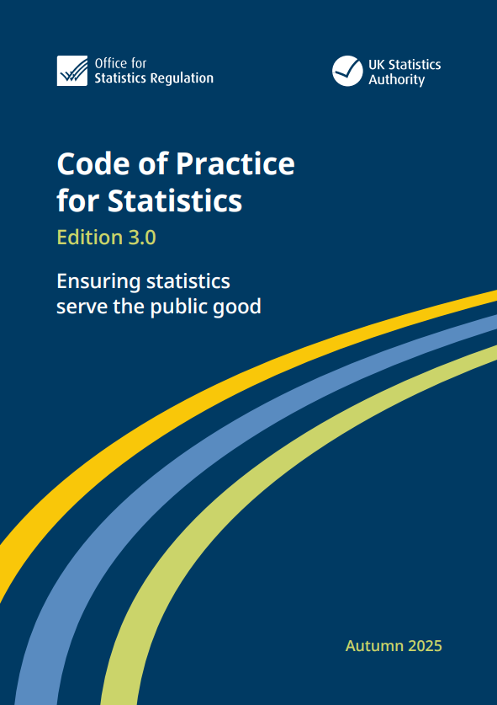
Context and Overview (2)
We follow the Code of Practice for Statistics.
The Code of Practice for Statistics sets the standards that those producing official statistics should apply to deliver statistics that serve the public good.
The Code is based on three core principles:
  Trust
  Quality
  Value
Our policy statements related to the Code and publication schedule are available on the DE website: Publications schedule, statements and consultations | Department of Education
We follow the Government Social Research Code when producing or commissioning research.

Slide 5

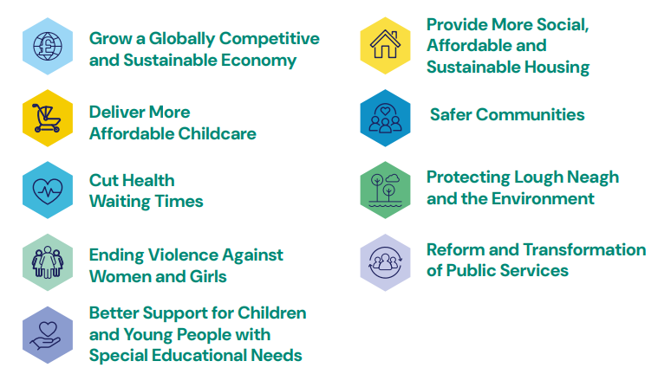
Context and Overview (3)
We provide statistics and produce analysis to support the Programme for Government.
We publish indicators on the PfG Wellbeing Framework to help monitor progress towards PfG commitments.

Slide 6

Context and Overview (4)
We produce statistics, research and analysis to support policy making, programme delivery, monitoring and evaluation in DE.
Our work provides a robust evidence base for the Minister of Education’s Vision and for supporting metrics in DE’s Business Plan
DE 2026-27 Business Plan | Department of Education
Strategic Priorities are:
  Raise learning standards through a modern curriculum, robust assessment, strong qualification pathways and effective school improvement.
  Strengthen inclusion, wellbeing and targeted support so every child can participate and succeed.
  Build an expert, skilled and supported education workforce.
  Modernise the education system through effective service delivery, governance, planning and investment.
  Expand participation and opportunity through early education, collaboration and shared learning.

Slide 7

Engaged Ambitious Skilled People
DE’s statisticians are reorganised into two separate teams:
Statistical Analysis Team (SAT) ​ - led by a Grade 6 statistician and at full complement includes 1 Grade 7, 6 Deputy Principal and 7 Assistant statisticians working across 6 main areas.
A Mapping and Charting Officer also sits within the SAT team.
Research and Evaluation Team (RET) - led by a Grade 6 statistician and at full complement includes 2 Grade 7s, 5 Deputy Principal and 3 Assistant statisticians working across two main areas.
Administrative support for both SAT and RET is provided by an admin EOII.​
More information about the work of the teams can be found on our website.

Slide 8
Statistical Analysis Team (SAT)
Grade 6
AS
Grade 7
DP
EO2
Head of SAT
Head of Census and Qualifications
EdIS, Development, Census support
Census
Attendance
Leavers, SAER
Leavers/SAER
Workforce
Workforce
Census
EdIS, Development, Census support
SAER
Leavers
School meals, AWP, Exams database
Vacant
Mapping and Charting Officer
Admin
Direct to Pauline Donnan

Slide 9
Statistical Analysis Team (SAT) Workplan
Our publication schedule sets out the dates we publish our bulletins on the DE website. This is the most visible part of our workplan.
We work on areas that underpin the production of high-quality statistics. This includes actions we take to produce our statistics more efficiently. In 2026/27 we will improve our methods to increase efficiency, continue to review the content and format of our outputs.
Our workplan on the following slides provides an overview of our teams and publications and details the areas we are developing in 2026/27. The slides are arranged by the strategic enablers in NISRA’s corporate plan.

Slide 10
Statistical Analysis Team - Official statistics outputs
School performance
Status: Accredited Official Statistics
School leavers
Status: Accredited Official Statistics
Pupil attendance
Status: Accredited Official Statistics
School enrolments
Status: Accredited Official Statistics
Teacher vacancies, sickness absence and substitution
Status: Official Statistics
School meals
Status: Official Statistics in Development
Teacher Workforce
Status: Accredited Official Statistics
Pupil suspensions and expulsions
Status: Official Statistics in Development

Slide 11
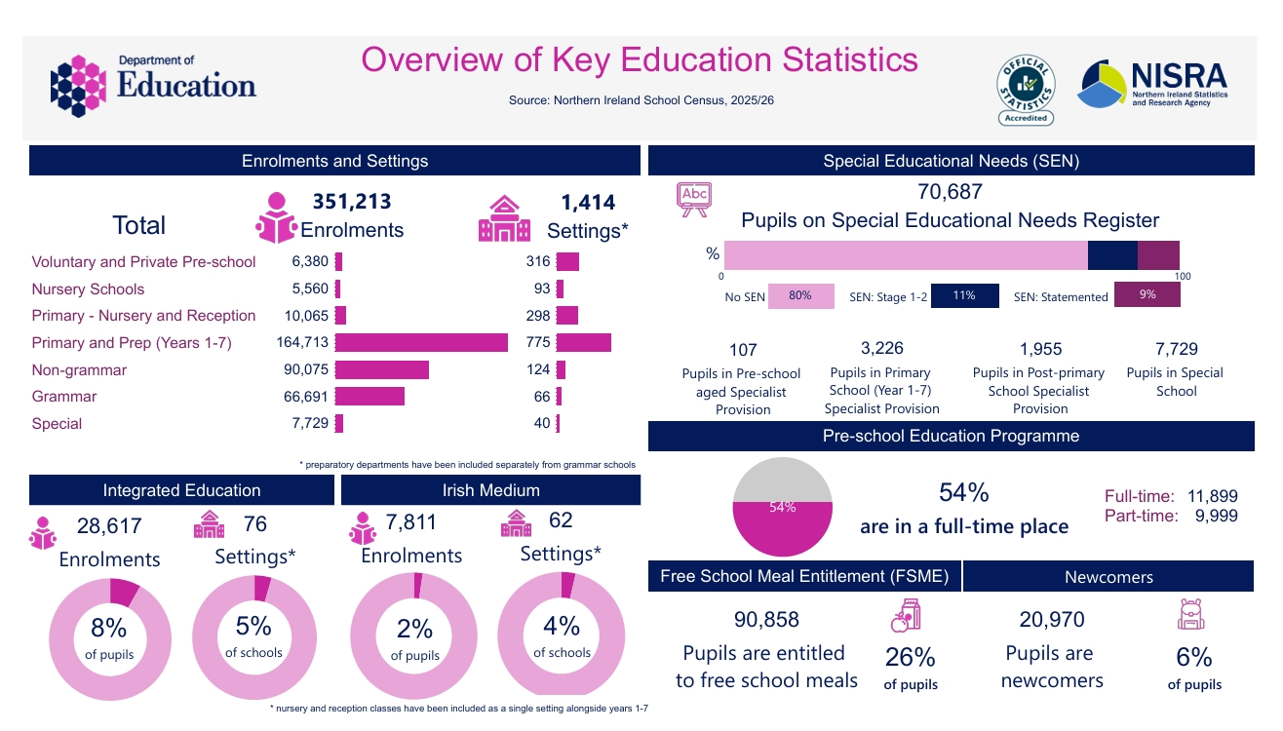

Slide 12
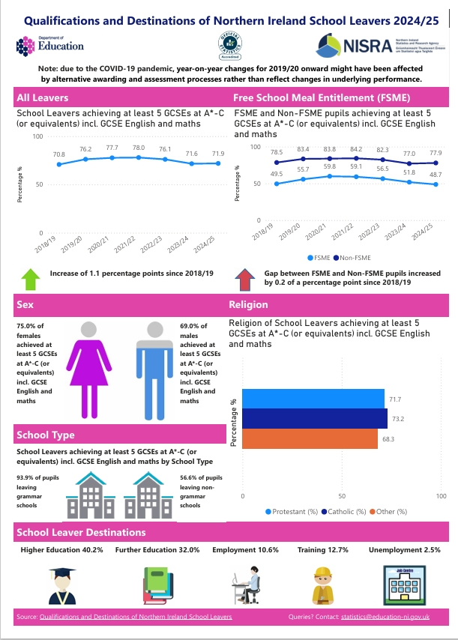
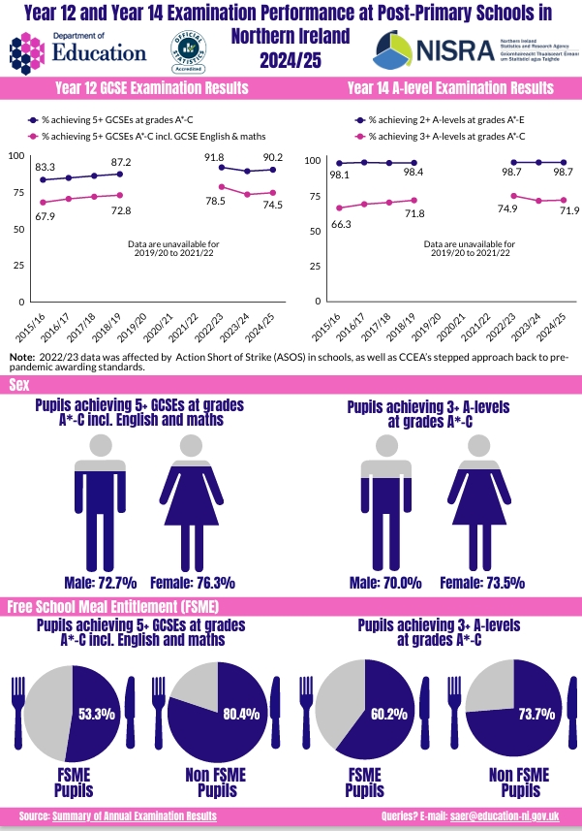

Slide 13
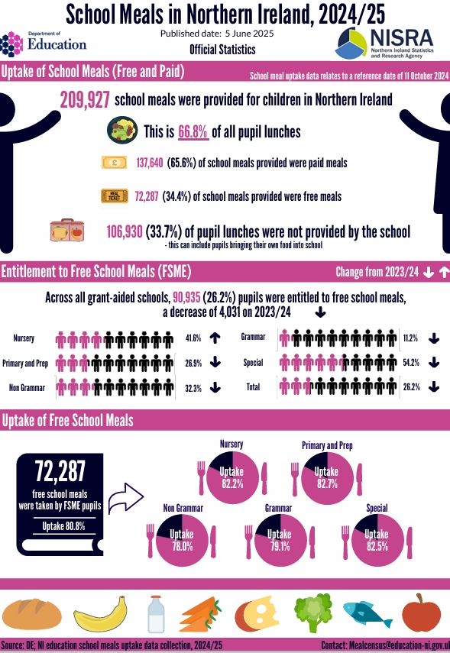
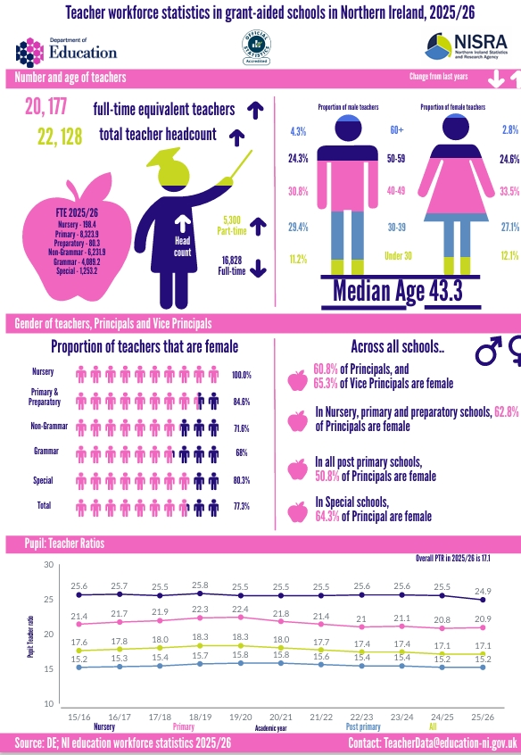

Slide 14
Research and Evaluation Team (RET)
Grade 6
AS
Grade 7
DP
Head of RET
Research Function
International Surveys
Research
SEN, Early Learning & Childcare, RAISE
RAISE
SEN, Early Learning & Childcare
SEN, Early Learning & Childcare
System Evaluation Framework
Research
System Evaluation Framework

Slide 15
Research and Evaluation Team (RET) Workplan
The Research & Evaluation Team will:
Manage international surveys including PISA (Programme for International Student Assessment), PIRLS (Progress in International Reading Literacy Study), and TIMSS (Trends in International Mathematics and Science Study).
Oversee DE modules within surveys including the Life and Times, Young Persons' Behaviour and Attitudes, and Continuous Household Surveys.
Undertake the School Omnibus Survey and provide survey and evaluation advice across areas including Integrated Education, Strule, and Statutory Assessments.
Provide support on policy evaluation and analysis for projects such as the Special Educational Needs (SEN) Reform Outcomes Framework, SEN Transformation, Early Learning and Childcare, and RAISE (Raising Achievement to Improve School Engagement).
Establish a dedicated education Research Function, including a 3-year Research Agenda and delivery Programme with associated governance arrangements and prioritisation process.

Slide 16

Strategic Data Assets
The Department collates, validates and maintains several important strategic data assets.
These are used across the Department, Education Authority and wider Government. They are a statistical base that informs a wide range of policy areas, including finance allocations; school estate development and planning; special education; integrated education; qualifications, attendance and destinations of school leavers. The data also evidences numerous Assembly questions, FOIs and queries from the public.
School census (including pupil attendance)
School Leavers
Exams database
Information on pupil enrolments, attendance, school leavers and exams is collected annually from schools, as part of our statutory data collections.

Slide 17

Purposeful Partnerships
We work closely with a wide range of stakeholders across the DE, EA, NISRA, and other public sector organisations. The statistics and analytical outputs produced by SAT support evidence-based policy development, operational planning, performance monitoring and research activities across multiple organisations. SAT facilitates appropriate and secure data sharing with a range of partners, ensuring that information is used effectively to support decision-making, improve outcomes for children and young people, and reduce duplication of effort across the public sector. Some examples include:
NISRA/DfE (Department for the Economy) to develop the Longitudinal Education Outcomes Northern Ireland linkage dataset.
The Department of Health to monitor CLA (Children Looked After) policy.
Council for the Curriculum, Examinations & Assessment (CCEA) to enhance the monitoring of qualification outcomes and also the analysis of Key Stage Assessment data.
NISRA to support the production of Northern Ireland population estimates, migration estimates and future development and production of Northern Ireland census-like statistics.
The Universities and Colleges Admissions Service (UCAS) to support the widening of access and participation within Higher Education. Transfers made will be in full compliance with all aspects of the UK GDPR.

Slide 18
List of Key Stakeholders
Government Departments
Economy
Research and Data Bodies
NISRA
Education and Skills Providers
Education Authority
Health
TEO
ONS
OSR
Communities
CCMS
CCEA
GTCNI
NICIE

Slide 19

User-focused Dissemination
In 2024/25, the Pupil Suspensions and Expulsions in Northern Ireland bulletin was released as Official Statistics in Development. As part of the transition to Accredited Official Statistics, we plan to undertake a user consultation to ensure that the content and outputs continue to meet users' needs. In addition, the methodology underpinning the data collection is expected to change in the coming years. Schools are transitioning to a new School Management System (SMS), and it is anticipated that suspension and expulsion data will, in future, be collected directly through this system. Once the new data collection and validation process is established, the resulting data will be assessed to determine its quality, completeness and accuracy. Subject to satisfactory outcomes from this assessment, it is hoped that the publication will be in a position to be considered for accreditation as Official Statistics.
The 2025/26 edition of the School Meals bulletin is planned to be published as Official Statistics in Development. This reflects an ongoing review of the data collection methodology following the identification of duplication in data collection activity, as equivalent information is already collected and held by the Education Authority (EA). The Statistical Analysis Team is therefore exploring how best to utilise this administrative data source to improve efficiency and reduce burden on data providers. In parallel, SAT is engaging with users to gather feedback on both the proposed methodology and the structure and content of the bulletin. This consultation will help ensure that the publication continues to meet user needs and provides relevant, high-quality information on school meal provision in Northern Ireland.
Users may access feedback forms to all our regular outputs to submit feedback to the Department.
We will provide data for NISRA’s data portal
We also work with NISRA’s Dissemination Branch and DE Press Office to ensure our outputs reach as wide an audience as possible in the right format.

Slide 20

Enabling Digital Infrastructure
Statisticians within the Department of Education have been working in close collaboration with colleagues in the Education Authority, particularly within the Education Information Solutions (EdIS) programme, to support the digital transformation of school data systems across Northern Ireland. This has included ongoing engagement on the replacement of the existing School Management System with the new Bromcom cloud based platform, which is being rolled out to schools on a phased basis and will provide a secure, centralised system for streamlining data flow between schools, parents and EA, reducing administrative workload, as well as supporting collaborative and multi-school working.
In parallel to above, collaborative working with colleagues in the Education Authority (EA) and external software developers has been ongoing to develop new data collection applications within EA Connect for nursery schools and voluntary and private pre-school settings. The new system will be introduced for the 2026 Census data collection and is expected to improve both the efficiency and quality of data capture, while reducing the administrative burden on both settings and statisticians in the Department.
RAP (reproducible analytical pipelines) and HTML outputs are well developed for most current DE publications.
During 2026/27 SAT will work with NISRA’s Tech Lab to update the “Teacher Workforce statistics” and “Teacher vacancies, sickness absence and substitution” publications to a new HTML format.
Pupil Suspensions and Expulsions and School Meals bulletins will also move to HTML formats.
We will work with NISRA colleagues to support the improvements in RAP and use of R through the RAP Working Group and R Code Peer Review Group.

Slide 21
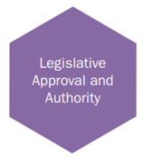
Legislative Approval and Authority
DE Statistical Analysis Team collects and processes personal information for statistics and research purposes, in order to meet the legal obligations and public functions of the Department of Education. These obligations and functions include:
  The statutory provisions providing the duties of the Department are contained in the Education Reform (NI) Order 1989. Article 3 places a duty on the Department to promote the education of the people of Northern Ireland and secure the effective execution by the Education Authority and other bodies of the Department’s policy in relation to the provision of the education service;
  The processing of data by the Department is provided for under statutory provisions listed in the Education and Libraries (NI) Order 2003. Article 37 provides that the EA and schools shall make such reports and returns and give such information to the Department as the Department may reasonably require for the purposes of its functions under any statutory provision.
  The UK GDPR requires that processing of personal data is only undertaken under a fixed list of conditions. Unless stated otherwise, DE Statistical Analysis Team’s processing of personal data/special personal data is carried out under the following condition: “Processing is necessary for the performance of a task carried out in the public interest or in the exercise of official authority vested in the controller.”
  In addition, Statistical Analysis Team processes special category data. The condition that DE Statistical Analysis Team process this data is that: “Processing is necessary for archiving in the public interest, scientific or historical research purposes or statistical purposes based on UK law.”

